Slide 1
Positive Behavior Interventions and Supports (PBIS)
Tier 2- Day 1
Bridget Walker, Ph.D.
Lori Lynass, Ed.D
Sound Supports
PBIS Coaches

Slide 2
Everett Public Schools
PBIS Tier 2 KWL Warm-up Activity
As you arrive please consider the following questions and be prepared to discuss:
Positive Behavior Interventions and Supports (PBIS) Tier 2 Practices
1. What Do You Know About Tier 2 systems?
2. What Do You Want To Know or Wonder About Tier 2?
3. What aspects of Tier 2 do you already have in place?
Notes:
BW
5 minutes pair-share then whole group share 10 min-
Draw from article, experience, visit……Record on large post it.

Slide 3

www.soundsupportsk12.com

Slide 4
Agenda:
Tier 2-Day 1
GOAL: Build a strong Tier 2 foundation
Review Tier 2 Readiness
Introduction to Tier 2 Systems
The Tier 2 Leadership Team
Student Identification for Tier 2
Function and Behavior- Foundations
Developing a Continuum of Tier 2 Supports (Part 1)

Slide 5
Group norms and expectations
Be Responsible
  Be an active participant
  Return promptly from breaks/activities – Hand/Bell Signal
  Use cell phone/laptop to support learning
  Be Respectful
  Use time well & meaningfully
  Ask relevant/clarifying questions
  Leave no trace- clean up your space
  Be Professional
  Enter discussion with an open mind
  Share the Air with others- all voices heard
  Allow quiet think time for self and others FIRST
  Be The Student You Wish To Have

Slide 6
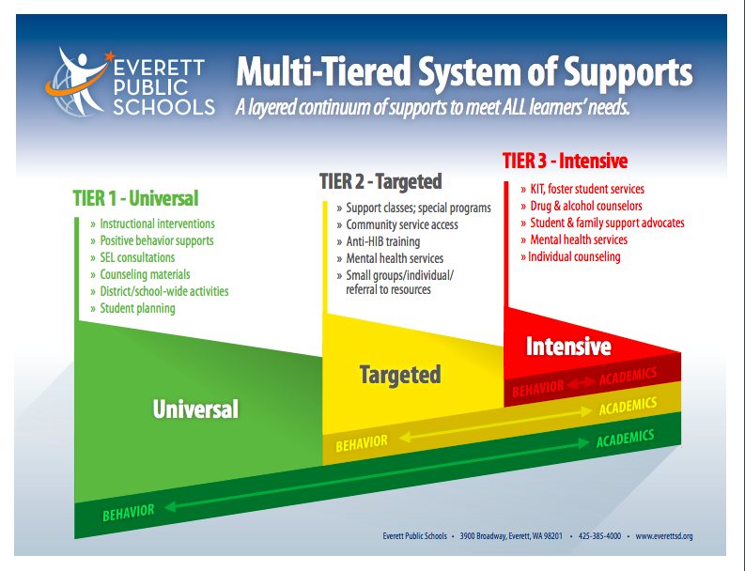
PBIS/MTSS-B In Everett Public Schools
Notes:
AB-

Slide 7
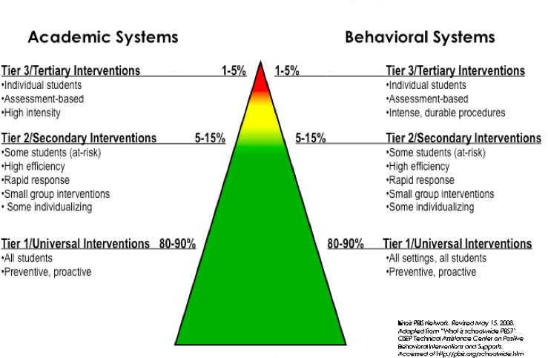
MTSS-B/PBIS Framework
Notes:
7

Slide 8
PBIS Systems and Structures to Build Predictable, Positive School Climate
MTSS Today
Teaching Practices, Activities & Curriculum that Support SEL Development
High Quality Teaching and Learning with Differentiated Approaches
Notes:
It seems we should use some version of this slide to highlight how important their role is across the model and to explain the MTSS/PBIS language thing.
Briefly review the 3 levels and concept of MTSS as integration of approaches.
Appear SEL image – universal = all kids, targeted = some/ small groups/short term,
Academic- a range of supports across needs to support academic development
Appear PBIS image- when you teach, reteach and acknowledge kids for expectations you are developing SEL. All integrates to support growth of whole child.

Slide 9
Why School-wide PBIS?
The fundamental purpose of PBIS is to make schools more effectve learning environments.
Predictable
Positive
Consistent
Safe
Notes:
The social culture of a school matters.
A continuum of supports that begins with the whole school and extends to intensive, wraparound support for individual students and their families.
Effective practices with the systems needed for high fidelity and sustainability
Multiple tiers of intensity

Slide 10
School-wide PBIS: Tier 1
Prevention
1. Common purpose & approach to discipline
2. Clear set of positive expectations & behaviors
3. Procedures for teaching expected behavior
4. Continuum of procedures for encouraging expected behavior
5. Continuum of procedures for discouraging inappropriate behavior
6. Procedures for on-going monitoring & evaluation
Notes:
10
Stress: Although most schools have a written code of conduct or discipline policy-- which is important-- it tends to focus on procedures for processing rule violations (#5 on the slide).
Effective school-wide discipline systems have a matching and strong proactive component that teaches and encourages pro-social behavior, and provides an on-going progress monitoring system.
The remaining five items are important but difficult to sustain without clear school-wide investments and structures in place.

Slide 11

Are We Ready for Tier Two?
For Tier Two supports to be most successful, basic components of Tier One should be in place.
* Check Classrooms
Time must be dedicated for Tier 2 to be implemented.
Support from staff and admin must be available.
Professional development & staff collaboration must occur.

Slide 12
Is Tier 1 in Place in Your Classrooms? Classroom Self-Assessment/Danielson
Classroom-wide positive expectations taught, encouraged & reinforced and match school-wide expectations
Teaching classroom routines & cues taught & encouraged
Ratio of 4-5 positive to 1 negative adult-student interaction
Staff Agree with and Understand Classroom and Office Managed Behaviors and implement consistently
Active supervision
Clear redirections for minor, infrequent behavior errors
Frequent pre-corrections for chronic errors
Effective academic instruction & curriculum for all learners

Slide 13
Table for Two….
How well established is Tier 1 in your classrooms- how do you know?
How might they use this classroom management self-assessment tool in your school?
Are you using any similar tool or process in your school to help all teachers implement Tier 1 effectiely- how is it working?

Slide 14
Fidelity Assessment in PBIS
Measures of “Systems” Outcomes (fidelity)
  TFI – Tiered Fidelity Inventory > 80% on subscales
  SAS - Self-Assessment Survey
Measures of “Practice” Outcomes
  Office Referral Data (SWIS or similar system)
  Absentee & Truancy Data
  Academic Data
  School Climate Measures
  Staff, Parent and Student Perceptions (survey or Anecdotal Data)

Slide 15
Tier 2 – Secondary
Early intervention
Specialized, short term, group administered system for students who display indicators of high-risk problem behavior & are not responsive to universal interventions
  Basic functional based thinking intervention decisions
  Daily behavioral monitoring/feedback
  Regular & frequent opportunities for positive reinforcement
  Family & community connections
  Academic supports/strategies for academic success
  Planned, focused SEL, social skills instruction and support
  Evidence based interventions
  Match student to least intensive intervention that meets his/her need(s)

Slide 16
Tier 3 – Tertiary
Intensive & Individualized
Specialized, individually administered system for students who display the most challenging problem behavior(s) & are not responsive to targeted group interventions
  Simple request for assistance
  Rapid response
  Functional based planning
  Behavior support planning
  Team-based problem solving process
  Data-based decision making
  Comprehensive service delivery derived from a wraparound process
  Not “just special education”
Notes:
I added this just to help put tier 2 in perspective, do you think we need it? It also completes an intro to the model. But if for time etc- we can let it gol

Slide 17
Who is Appropriate for Secondary Intervention?
APPROPRIATE
Low-level problem behavior (not severe)
2-5 referrals or internalizing issues
Behavior occurs across multiple locations
Examples
  talking out
  minor disruption
  work completion
INAPPROPRIATE
Serious or violent behaviors/ infractions
Extreme chronic behavior (6+ referrals)
Require more individualized support
  FBA-BIP
  Wrap Around Services

Slide 18

Evidence Based Practice
Tier 3: FBA/BSP (5%)
6+ Discipline Referrals
5 + Referrals
TIME & CHANGE in Staff behavior required to generate desired outcome
Tier 2: CICO (15%)
3-5 Discipline Referrals
2-4 Referrals
Tier 1: SW-PBIS (80%)
0-2 Discipline Referrals
0-1 Referrals
Notes:
At the bottom of the triangle we are teaching and asking kids to change their behavior. At the top we are changing our own.

Slide 19
Tier 2 Guiding Principles
Students who are at-risk benefit from MORE:
  Clearly defined expectations
  Frequent feedback from supportive adults
  Consistency and predictability
  Abundant positive reinforcement
Problem behavior and academic success are often linked
Behavior support strategies focus on building positive adult-student relationships

Slide 20
General Process for Tier 2 Systems
Establish Tier 2 Support Team to guide/lead process (not the same as your PBIS Leadership team).
Orient staff, families and students to the focus of the Tier 2 support system
Continue to establish behavioral competence, strategies within your school
Continue to develop/strengthen three tier system of school-wide behavior support

Slide 21
General Process Cont’d
Develop a continuum of evidence based Tier 2 supports with clear entry/exit criteria
Establish a data decision system for matching level of intervention to student
  Simple & direct request for assistance process for staff
  Data decision rule for requesting assistance based on number of major behavioral incidents and/or other established indicators
Establish a continuous data-based system to monitor, evaluate, & improve effectiveness & efficiency
  Are students displaying improved behaviors?
  Are staff implementing procedures with high fidelity?
  What can be modified to improve outcomes?
  What can be eliminated to improve efficiency?

Slide 22
Features of Tier 2 Interventions
Assumes Tier 1 School wide PBIS is in place – TFI, SAS
Involves a problem-solving focused behavior support team
Screening to identify a % of students in need of more than Tier 1 supports
Readily available and easily accessible
Low time commitment from teaching staff
Adequate resources allocated (admin, team)
Uses efficient, available evidence based practices
Includes data-based progress monitoring & decisions
Have an entry, progress monitoring & exit criteria, with non-responders moving to Tier 3
(Hawken, Vincent, & Schumann, 2008).
Notes:
22

Slide 23
Mapping Basic Tier 2 Interventions
Begin with Least Intensive Intervention possible that matches student need. Increase/adjust supports based on data.
Function Based Matching to Existing Supports
Basic Check In & Check Out Intervention
Small Group Academic, Social-Emotional, Groups
Integrated Interventions Tier 2 Interventions
Identify Students (SWIS, Screening, Referral etc.)
Mentoring or Make a Mentor
Least Intensive More Intensive
(Walker, B., 2016)

Slide 24

Tier 2: Sample Interventions
  Targeted SEL Groups
  Check In/Check Out, Check,
  Connect & Expect etc.
  Executive Functioning Skill Groups
  Learning Strategies and Study Skills
  Academic Support Groups
  Homework Club
  Self-Monitoring Plans
  Mentoring/Make a Mentor
  Behavior Contracts
  Class Pass System

Slide 26
Tier 2 Readiness Assessment &
Poster Activity
On Your Poster List:
  Ways Your School is Ready For Tier 2
  Readiness Steps That Need to Occur
  Challenges to Tier 2 Implementation
  Promoters to Tier 2 Implementation
  Look at indicators of Tier 2 readiness on page 5 of your Tier 2 packet to guide your thinking.

Slide 27

Tier 2 – Building the Support Team
The Tier II Team uses a range of data to regularly identify students in need of more social/behavioral supports and to establish and monitor the systems and practices that serve these students

Slide 28
Establishing the Tier 2 Team
May be part of the existing behavior leadership team
May be an extension of the existing behavior leadership team
May be a stand alone team, often these teams look at Tier II & III
* Such a team may already exist in your school
Notes:
May include academics, or may be separate

Slide 29
Two Team Format
Universal PBIS Team
Tier 1
PBIS Team
Tier 2 and Tier 3

Slide 30
3-Tiered System of Support
Universal
Team
Meeting
Secondary Systems Team
Meeting
Problem Solving Team Meeting
Tertiary Systems Team Meeting
Standing team; uses FBA/BIP process for one student at a time
Uses process data; determines overall intervention effectiveness
Plans schoolwide & classroom supports
Uses process data; determines overall intervention effectiveness
Universal Support
Check-In Check-Out
Skills Groups
Complex
FBA/BIP
Wraparound
Brief
FBA/BIP
Group w. individual
feature
Brief FBA/BIP
USDOE-OSEP Tertiary Demo Project
#H326M0060010
Notes:
30
30

Slide 31
Tier 2 Team Members
Tier 2 (Intervention) Coach
Counselor
Psychologist
Special education
Teachers
Administrator
Paraprofessionals
*FBA/BIP Knowledge

Slide 32
Tier 2 Teams: Meeting Smarter and More Efficiently
Assign Roles/Responsibilities and keep to them!
Structure an Agenda that allows the group to cover a number of items/students in each meeting.
Review FERPA and other confidentiality guidelines with the team.
Limit “Admiring the Problem” to no more than 10% of allotted time for discussion of that student (and keep to it).
Take minutes and share promptly with team
Identify indicators to begin a support and indicators student is ready/needs a change.
Build a Tier 2 Supports/Intervention Grid to guide decision-making

Slide 33
Establish Team Roles
Identify who will serve in each role.
Rotate every 3 months or so to develop capacity across team members and to provide some variety.
Each role needs to be filled for each meeting.
Identify who will step in for each role in the event someone is absent.
• Facilitator- runs the meeting (not the administrator)
• Time keeper- keeps group on time and on task
• Note taker/action plan recorder- records notes/decisions & shares with relevant others (per communication protocol)
• Data analyst- reviews and preps data ahead of meeting, shares with team
• Active team members- everyone participates and supports

Slide 34
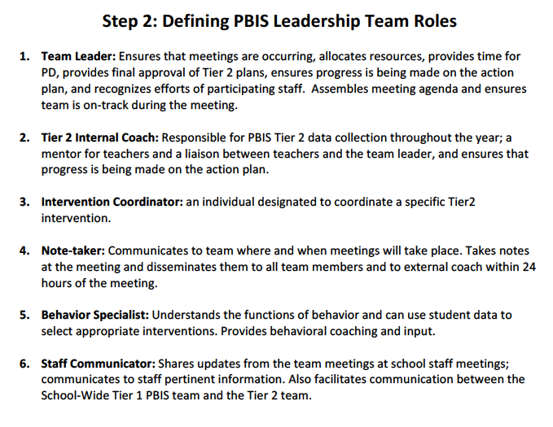
More on Team roles

Slide 35
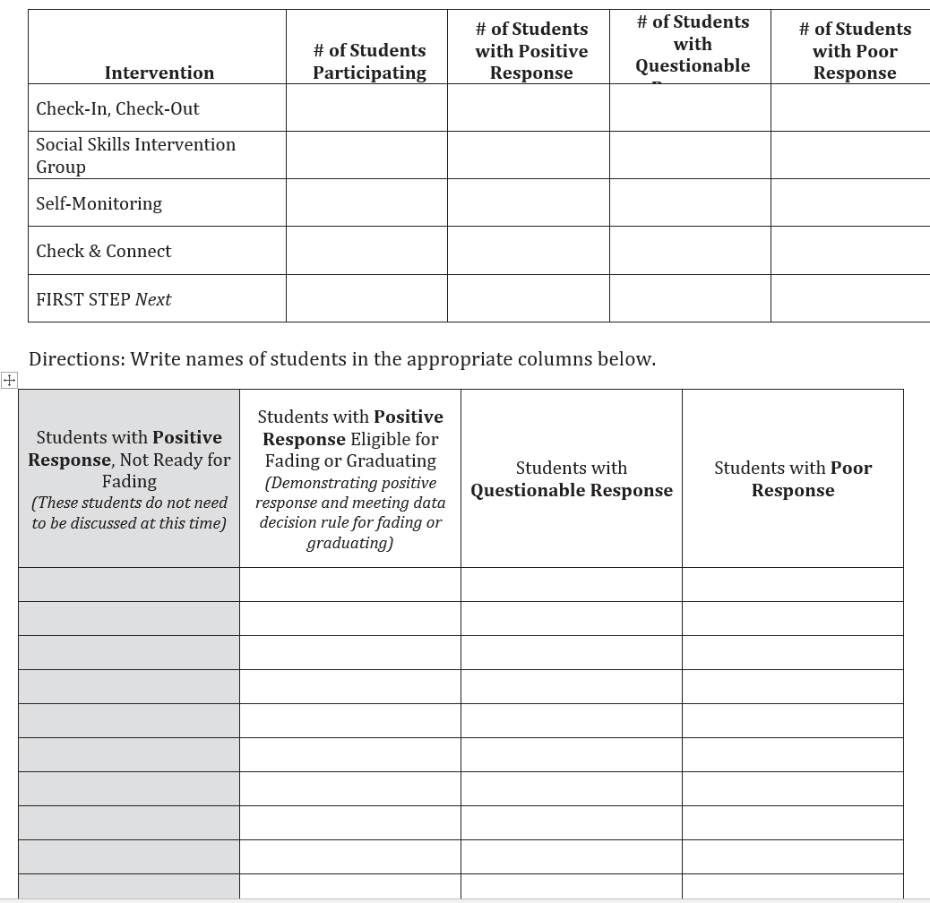
Tier II Team meeting organizer

Slide 36
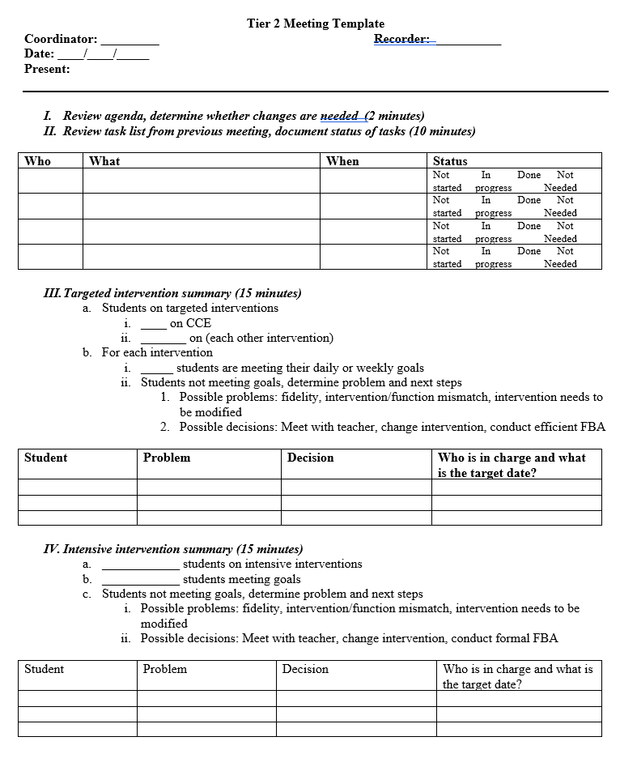
Tier II Team meeting organizer

Slide 37
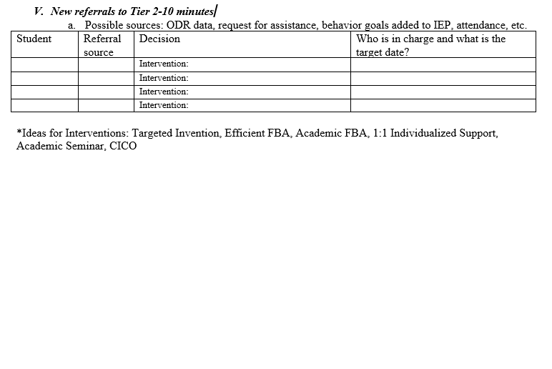
Tier II Team meeting organizer

Slide 38
Team meeting examples
https://youtu.be/z6MtVtRSXMs
https://youtu.be/ABGBn87HCe4
Discuss: What did you notice?
Notes:
https://youtu.be/z6MtVtRSXMs
https://youtu.be/ABGBn87HCe4

Slide 39
Desired Meeting Procedures/Systems
Establish roles/back up roles
Establish clear agenda and follow it in the meeting; have a clear flow; deliberately end one topic before moving to the next
Designate tasks, agreements, decisions and actions at the top of the minutes
End meeting with w/ clear expectations, tasks, responsibilities
Strive for consensus/compromise; if needed majority vote carries the decision. Team members support group decisions outside of meeting
Clarify acronyms and other language
Be aware of and spread workload across the team
Practice good meeting hygiene; Support the team in learning new protocols and practices over time

Slide 40
Team Work: Reviewing Foundational Tier Two Implementation
Review page 19 of the Tier 2 handbook (Tier Two Action Plan Checklist: Tier 2 Teams)
  Discuss the readiness of your Tier 2 team.
Review the Tier 2 PBIS meeting fidelity review checklist on page 14 of the Tier 2 packet.
  What aspects of this team and process are already in place?
  Which aspects the team meeting process need to be strengthened? What steps would you prioritize at this time?
  Are there any challenges that will need to be addressed as you move forward with this team? If so, how can they be addressed?

Slide 41
MTSS Prompts A Shift in Thinking
What about the interaction of the curriculum, instruction, learners, and learning environment should be altered so that the student(s) will learn?
What about the student is causing a problem?
Instead
This shift alters everything else!
Adapted from Batsche and Elliott materials (citing Ken Howell)
Notes:
A major conceptual shift. This puts the problem in the context of alterable variables and moves it outside of the student. When the focus of team meetings is on the discovery of instructional changes that will enable learning, the content of the meeting is quite different from one focused on the discovery of a disability.
(*Sometimes allowing time for discussion of this slide can bring about significant “aha”s.)
Remember our MTSS approach where we are focusing on what we can do or what supports (i.e. instructional changes) we can put in place to help the student be successful. This is a major conceptual shift. This puts the problem in the context of alterable variables and moves it outside of the student
FSCP Ideas:
Use of out-of-school time is considered a major factor in the achievement gap; and can be altered with family and community partnering; coordinated before and after-school programs, summer learning, homework support, technology access – and their interaction with the other variables can be influential

Slide 42

Identifying Students For Tier 2/3 Supports:
Office Referral Data
Academic Data
Classroom Minors Data
Attendance Data
Frequency of Nurse’s Office Visits
Mental Health Concerns
Drug/Alcohol Concerns
Student Self Refers
Social Emotional Screening Data
Teacher/Counselor/Parent Request

Slide 43
Tier 2 Request for Assistance
Using a standard process helps team gather needed data for the meeting
Encourages staff to use less intensive in-class supports before tapping into to Tier II Supports
Helps to assess the function of the behavior

Slide 44
Request for Assistance
Student name
Date of referral
Name of Referring Person
Reason for Referral
Description of behavior
When behaviors occur
Hypothesized reason/function of behaviors
Prior interventions

Slide 45
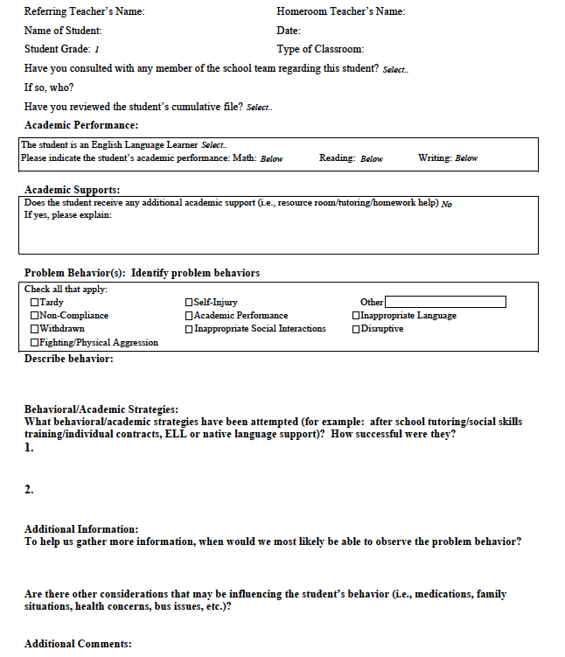
Example

Slide 46
Data Driven
4 majors in a two week period
6 minors=1 major
Team assists staff in completing Tier II Referral Form
Observation completed
Teacher Nomination
Problem Solving Team Referral
Screening
Document behaviors and interventions
Teacher completes Tier II Referral Form
Observation completed
Tier II Team meets within one week and makes decision
Tier II Team meets within one week and makes decision
Kirksville Public Schools
Early Childhood Learning Center
Lewis, T., PBIS.org

Slide 47
Comprehensive Screening
Attendance, Social, Emotional, Discipline & Behavioral Screening Data
Academic Records & Screening Data
Group of Students With Targeted Needs

Slide 48

Externalizing Behaviors
Behaviors focused outward towards others or environment
Typically occur too often or too much
Examples:
  aggression towards people, animals or objects
  arguing, defiant or non-compliant
  calling out or disruptive to learning
  high levels of movement
  Inattentiveness, distractibility

Slide 49

Internalizing Behaviors
Behaviors focused inwardly towards self
Typically self-imposed, may not occur frequently, and appear to allow the student to avoid social events
Examples:
  Not interacting with other people
  Withdrawing or frequently avoiding social situations
  Overly shy or timid
  Often fearful or submissive
  Appears frequently depressed
  Self harm at most intensive

Slide 50
Sample List of Students Identified Through Schoolwide Screening
How could this information help you determine where your limited support resources should focus?

Slide 51
Social Emotional Screening
Use of an evidence based screening tool under the guidance of a trained PBIS Coach:
  Four-Six weeks into the school year
  Spring (four-six weeks before the end of the year)
  * Academic Screening Data Also Considered
  Should be used only once a solid Tier 2 infrastructure is in place with a range of interventions ready to implement.
  School district administrators need to be involved in identifying and supporting piloting and implementation of a screening tool.

Slide 52
Table for Two….
How are you currently identifying kids with emerging needs?
What data sources are you using?
What adjustments to your current systems need to be made to identify students with EMERGING (Tier 2) needs?

Slide 53
Team Work: Tier 2 support Process
How are students currently identified for more intensive supports in your school?
  Request for assistance?
  Number of disciplinary referrals?
  Other types of data?
Are all staff and parents aware of the process?
Does your existing process focus more on identifying students with emerging issues or on students with more individualized needs?
How can the process be streamlined/improved to help your team identify students who will benefit from early intervention/supports?
Look over the samples on pages 22-24 in your Tier 2 packet
Notes:
Until 11

Slide 54

Understanding challenging behavior

Slide 55
Considerations for Tier 2 & Tier 3
Behavior must be considered within context in which it is observed
As intensity of problem behavior increases, so must intensity & complexity of functional behavioral assessment & behavior support planning process

Slide 56
Using positive supports to impact behavioR
Provide training and prompts/supports to give students positive alternatives to meet their needs
Keep problems from occurring. Most energy and time should go here…
Student Progress
Prevent
Problem Behavior
Teach
Desired or Replacement Behavior
Reinforce
Emerging Desired Behaviors
Recognize and acknowledge attempts to use replacement behaviors
(Modified from 2009, Dunlap, Lovannone & English)

Slide 57

“Can’t Do versus Won’t Do”
“Can’t Do or Don’t Know When To Do It”
- Skill Deficit
- Performance Deficit
- Perception Deficit
“Won’t Do”
- Function of Behavior

Slide 58
Skill Building & Practice
TargetedSocial Skills Groups/Instruction
  Assertion Skills, Anger Management, Friendship Skills, Empathy Skills, Communication, Problem-solving, Self-Calming,
Executive Function Skills Groups
  Organization Skills, Emotional Control, Time Management, Learning & Memory Strategies
Academic Skills Groups
  Context Reading Skills, Math Skills, Writing Supports
  Study Skills

Slide 59
Knowing Function of Behavior to Determine Intervention

Slide 60
What is Function Anyway?
Humans repeat behavior because in some way it meets a deep need.
To OBTAIN or GET something we want: Attention (positive or negative) from peers and/or adults, sensory input or things like money, toys, stuff
To AVOID or Delay something we don’t want: Attention (positive or negative) from peers and/or adults, sensory input, Tasks or other activities that we don’t like.
Research has shown that the more often a behavior meets it’s function for a person, the more often it will occur.
The longer the pattern has been in place the more time it will take to change it.
Notes:
Handout menu of ideas (TR)

Slide 61
Functions of behavior
Example
Horner & Sugai at www.pbis.org
Notes:
Attention getting kid video
https://www.youtube.com/watch?v=lXP5rFAJQek
For example-
Many students use off topic comments/inappropriate language to obtain
attention from peers through their reactions and to escape the task at hand.
In this example, social reinforcement is obtained from the peers and the
adult.
Remember reinforcement is positive and negative.
NOTE:
When control is offered as a possible function- think about what is underlying that perception.
Control can be a way:
To hide skill deficits; therefore escaping/avoiding a task
To hide fears around social acceptance; therefore escaping/avoiding a situation
For an individual to assert themselves; therefore gaining/obtaining the attention of peers/adults

Slide 62
Functions of Behavior
Antecedent | Behavior | Consequence
1. Teacher asks student to complete the assignment | 1. Student rips up paper | 1. Teacher sends student to “Time Out”
2. Phone rings, parent puts child down to answer the phone. | 2. Child starts crying | 2. Parent puts phone down, and cradles child saying, “shhhh”
3. Teacher tells student he/she has to wait | 3. Student hits his/her teacher | 3. Teacher brings student outside classroom and explains hitting is wrong.
4. Teacher walks away from one student to help another. | 4. Student runs out of the classroom. | 4. Teacher chases student
5. Parent tells child that they can’t have the item he/she requested. | 5. Child screams and jumps up and down. | 5. Parent gives the item to calm them down.
Escape:
Task or activity
Obtain:
Attention
Obtain:
Attention
Obtain:
Attention
Obtain: tangible
Notes:
So why does this matter? If we all understand the purpose of a behavior, we understand why and how to intervene. If a student blurts out repeatedly in class and we know the function is attention, that helps us figure out what we need to do to stop the behavior. Stop giving him attention and helping him find another behavior to get attention that is more acceptable.

Slide 63
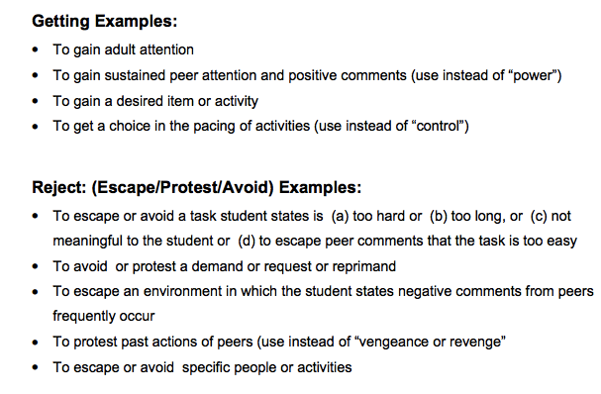
What About Control & Vengeance?
http://www.pent.ca.gov/dsk/BIPdeskreference2013.pdf

Slide 64
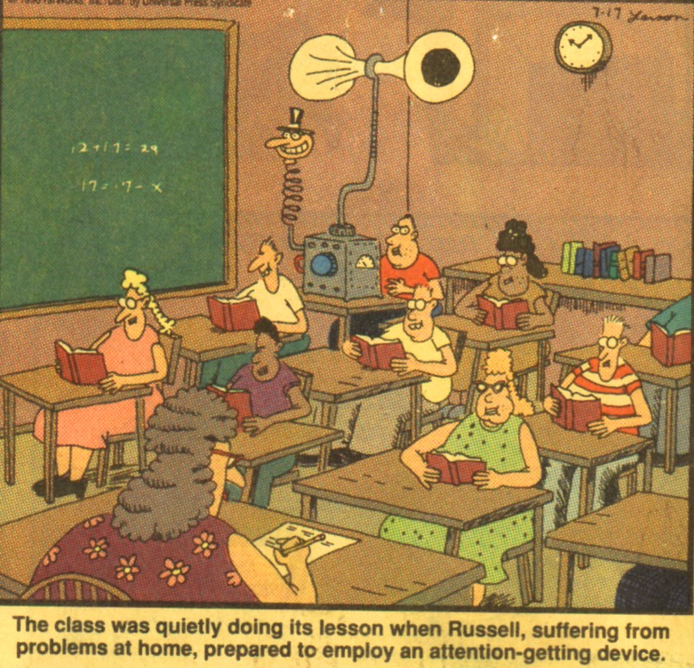
Function of Behavior

Slide 65
We Also Have To Think Functionally When Choosing Interventions
“Problem Behaviors” are functional skills for students (even survival skills)
Interventions must consider the purpose of behavior (from student’s perspective) and address the same need as efficiently and effectively as the behavior you want to change.
The same surface behavior (e.g. calling out in class) can serve different functions
Seek a match from school’s intervention menu for the functional needs of each individual student

Slide 66
Creating a PBIS Matrix with Prompts for Student(s) Dealing with Anxiety, Other Internalizing or Avoidance Function Behaviors
Expectations | All Settings | Lunch | Group Learning
Engaged & Aware | Listen to others Give your best effort Complete your work | Invite those sitting alone to join in Introduce yourself to new friends | Introduce myself Focus on task Do my role Ask questions when needed
Respectful | Use friendly language Hands/feet to self Help/share with others | Choose quiet or social lunch area Use cognitive coping skills Invite friends to join me | Share the AIR so everyone is heard Use cognitive coping strategies Active listening
Responsible | Be on task Be prepared Recycle Clean up after self Follow Directions | Use my breathing technique Listen to my signals Use my plan | Use my breathing technique Listen to my signals Use my plan Ask for a break if needed

Slide 67
THS Targeted Intervention Quick Sort
Function of Behavior /Student Needs | Blazer Check | Mentoring | Academic Seminar/ Boot Camp | Behavior Contract | Small Group Counseling | Ripple Effect
Adult Attention | X | X | X | X | X
Peer Attention |  |  | X |  | X
Encouraging Adult Relationship | X | X |  | X | X
Learn Replacement Behavior | X | X | X |  | X | X
Prompts for Behavior Expectations | X | X | X | X | X | X
Monitor Risk Factors | X | X |  |  | X
Learn Problem Solving Skills | X | X |  |  | X | X
School/Home Communication System | X | X |  | X | X
Notes:
District compiled a list of interventions and what need function/need the intervention addresses.
These are identified researched based interventions
We do not have all the interventions in place at this time, but are working towards that goal

Slide 68
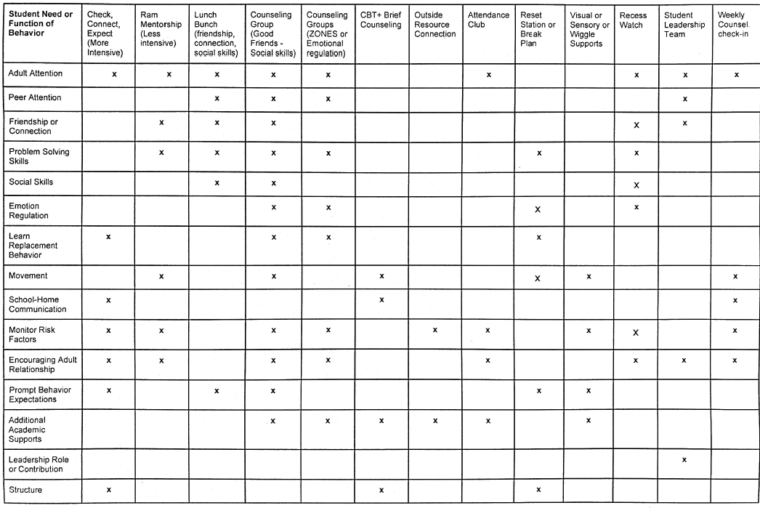

Slide 69
Blank Function Based Supports Quick Sort
Function of Behavior & Supports Available
Gain Adult Attention
Gain Peer Attention
Obtain Items
Avoid Adult Attention
Avoid Peer Attention
Obtain Sensory
Avoid Sensory

Slide 70
Team Work: Targeted Interventions Quick Sort for Your School.
Use the blank matrix to list targeted supports already available in your school across the top.
Then mark what functions this support meets for students.
Do you have existing supports that match each function? Are there areas that you need to address?
How can your team use a matrix like this to match identified students to to early intervention, targeted supports?
Discuss how you might monitor the efficacy of these supports on student performance over time.

Slide 71
Final Action Planning Tasks
Return to the Tier 2 Planning Checklist on pages 19-20.
Review items 1-3 and outline next steps in developing these aspects of Tier 2 foundational systems
Identify how your PBIS coach can help you with further development of these areas.
Return to the Quick Sort form and student supports that your team identified as in place.
Go to page 35 in you Tier 2 Manual. How many of these questions have been developed for these practices?
Use this implementation outline to further develop the supports you do have in place for students with Tier 2 needs
Identify how your PBIS coach can help you with further development of these areas.

Slide 72
Tier 2: Agenda for Day 2
June 26, 2019 (JHS)
Overview of Tier 2 Supports: Attention/Tangible Based Support: Check in Check Out (CICO) Programs
Strategies for Acquisition and Performance Based Issues: • Self-Monitoring • Class Pass Intervention • Targeted Social Skills • Behavior Contracts • School-Home Note
Sharing Implementation Ideas Across Schools
Review Tier 2 Action Plan Checklist
Team Action Planning

Slide 73
Thank you!
Lori Lynass, Ed.D.
lynassl@gmail.com
Bridget Walker, PhD.
bridgetwalkerphd@gmail.com

Slide 74


